Slide 1
MATH-234 Multivariable Calculus
Dr. Atifa Kanwal
Office # A-213
atifa.kanwal@seecs.edu.pk

Slide 2
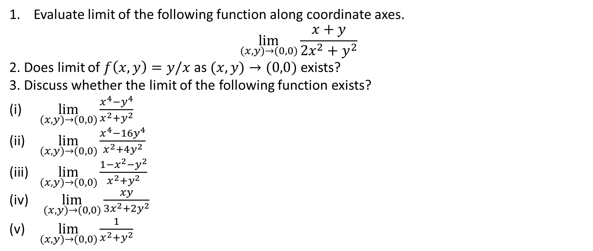
Practice Questions:
Evaluate limit of the following function along coordinate axes.
$$\lim_{(x,y)→(0,0)}{\frac{x+y}{2x^{2}+y^{2}}}$$
2. Does limit of $f\left(x,y\right)=y/x$ as $(x,y)→(0,0)$ exists?
3. Discuss whether the limit of the following function exists?
$\lim_{(x,y)→(0,0)}{\frac{x^{4}−y^{4}}{x^{2}+y^{2}}}$
$\lim_{(x,y)→(0,0)}{\frac{x^{4}−16y^{4}}{x^{2}+4y^{2}}}$
$\lim_{(x,y)→(0,0)}{\frac{1−x^{2}−y^{2}}{x^{2}+y^{2}}}$
$\lim_{(x,y)→(0,0)}{\frac{xy}{{3x}^{2}+2y^{2}}}$
$\lim_{(x,y)→(0,0)}{\frac{1}{x^{2}+y^{2}}}$

Slide 3
RECAP
$$\lim_{\left(x,y\right)→\left(x_{0},y_{0}\right)}{\frac{f\left(x,y\right)}{g\left(x,y\right)}}$$
lim┬((𝑥,𝑦)→(𝑥_0,𝑦_0 ) )⁡〖𝑓(𝑥,𝑦)/𝑔(𝑥,𝑦) 〗
$f\left(x_{0},y_{0}\right)≠0$ and $g\left(x_{0},y_{0}\right)≠0$
𝑓(𝑥_0,𝑦_0 )≠0 and 𝑔(𝑥_0,𝑦_0 )≠0
$$\frac{f\left(x_{0},y_{0}\right)}{g\left(x_{0},y_{0}\right)}$$
𝑓(𝑥_0,𝑦_0 )/𝑔(𝑥_0,𝑦_0 )
$$\frac{f\left(x_{0},y_{0}\right)≠0}{g\left(x,y\right)→0}$$
(𝑓(𝑥_0,𝑦_0 )≠0)/(𝑔(𝑥,𝑦)→0)
$$\frac{f\left(x,y\right)}{g\left(x,y\right)}→±∞$$
𝑓(𝑥,𝑦)/𝑔(𝑥,𝑦) →±∞
$$\frac{f\left(x,y\right)→0}{g\left(x,y\right)→0}$$
(𝑓(𝑥,𝑦)→0)/(𝑔(𝑥,𝑦)→0)
Limits along curves
(Curves will be specified in this case)
Factorize and rationalize to remove zero denominator

Slide 4
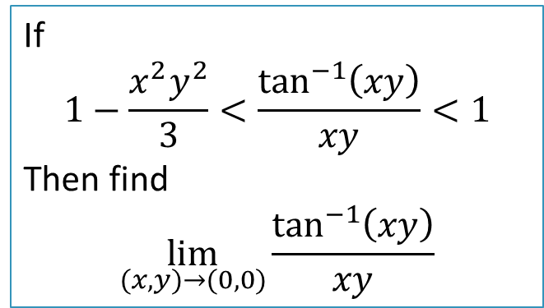
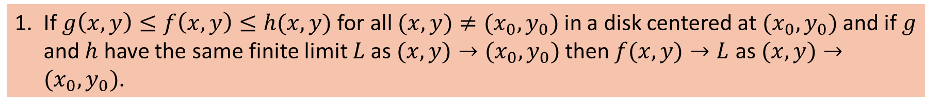
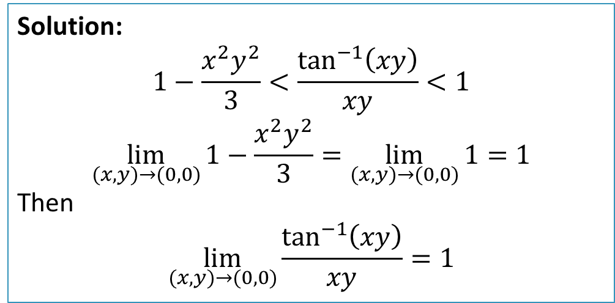
Sandwich Theorem for Functions of two variables
If $g\left(x,y\right)≤f\left(x,y\right)≤h(x,y)$ for all $(x,y)≠(x_{0},y_{0})$ in a disk centered at $(x_{0},y_{0})$ and if $g$ and $h$ have the same finite limit $L$ as $(x,y)→(x_{0},y_{0})$ then $f(x,y)→L$ as $(x,y)→(x_{0},y_{0})$.
Example 5:
Solution:
$$1−\frac{x^{2}y^{2}}{3}<\frac{\tan^{−1}\left(xy\right)}{xy}<1$$
$$\lim_{(x,y)→(0,0)}{1−\frac{x^{2}y^{2}}{3}}=\lim_{(x,y)→(0,0)}{1}=1$$
Then
$$\lim_{(x,y)→(0,0)}{\frac{\tan^{−1}\left(xy\right)}{xy}}=1$$
If
$$1−\frac{x^{2}y^{2}}{3}<\frac{\tan^{−1}\left(xy\right)}{xy}<1$$
Then find
$$\lim_{(x,y)→(0,0)}{\frac{\tan^{−1}\left(xy\right)}{xy}}$$

Slide 5
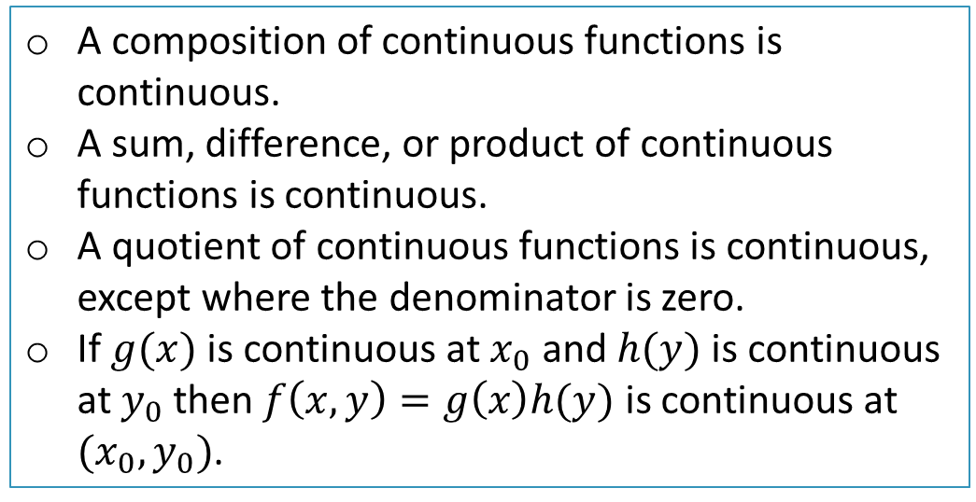
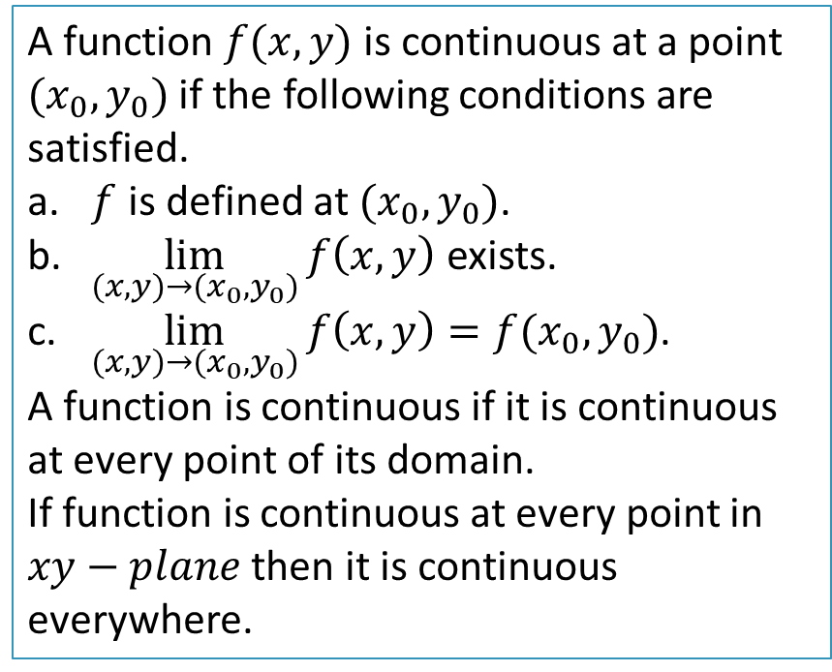
Continuity for Functions of Two Variables
A function $f(x,y)$ is continuous at a point $(x_{0},y_{0})$if the following conditions are satisfied.
$f$ is defined at $(x_{0},y_{0})$.
$\lim_{(x,y)→(x_{0},y_{0})}{f\left(x,y\right)}$ exists.
$\lim_{(x,y)→(x_{0},y_{0})}{f\left(x,y\right)}=f(x_{0},y_{0})$.
A function is continuous if it is continuous at every point of its domain.
If function is continuous at every point in $xy−plane$ then it is continuous everywhere.
Properties
A composition of continuous functions is continuous.
A sum, difference, or product of continuous functions is continuous.
A quotient of continuous functions is continuous, except where the denominator is zero.
If $g(x)$ is continuous at $x_{0}$ and $h(y)$ is continuous at $y_{0}$ then $f\left(x,y\right)=g\left(x\right)h(y)$ is continuous at $(x_{0},y_{0})$.

Slide 6
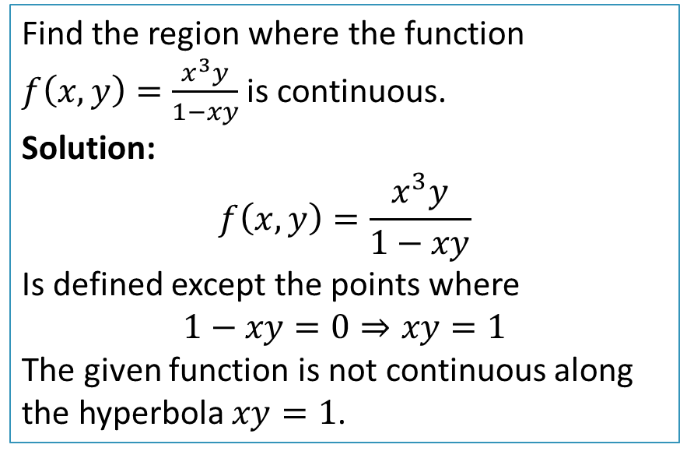
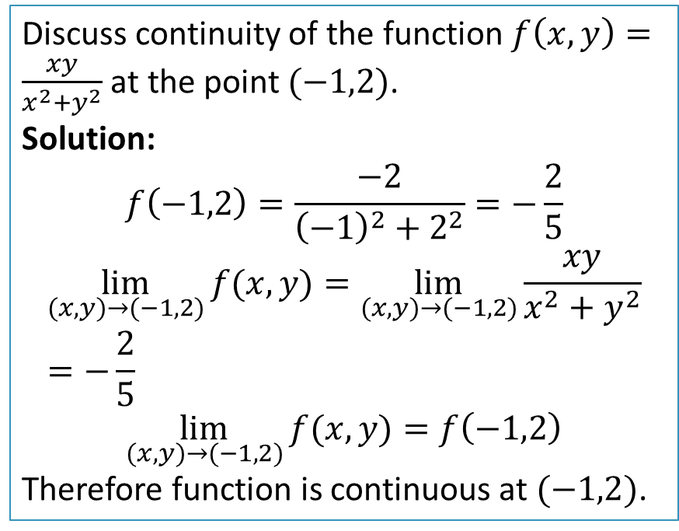
Example 1:
Example 2:
Discuss continuity of the function $f\left(x,y\right)=\frac{xy}{x^{2}+y^{2}}$ at the point $(−1,2)$.
Solution:
$$f\left(−1,2\right)=\frac{−2}{{\left(−1\right)}^{2}+2^{2}}=−\frac{2}{5}$$
$$\lim_{(x,y)→(−1,2)}{f(x,y)}=\lim_{(x,y)→(−1,2)}{\frac{xy}{x^{2}+y^{2}}}=−\frac{2}{5}$$
$$\lim_{(x,y)→(−1,2)}{f(x,y)}=f\left(−1,2\right)$$
Therefore function is continuous at $(−1,2)$.
Find the region where the function $f\left(x,y\right)=\frac{x^{3}y}{1−xy}$ is continuous.
Solution:
$$f\left(x,y\right)=\frac{x^{3}y}{1−xy}$$
Is defined except the points where
$$1−xy=0⇒xy=1$$
The given function is not continuous along the hyperbola $xy=1$.

Slide 7
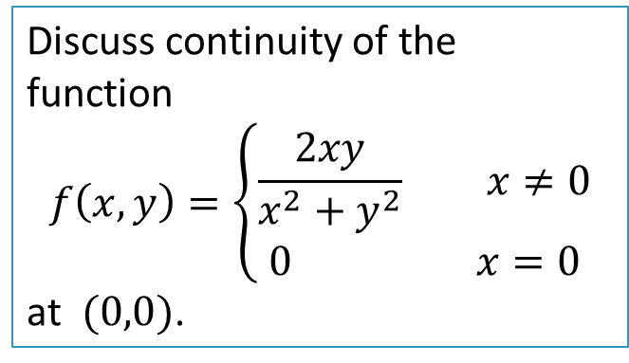
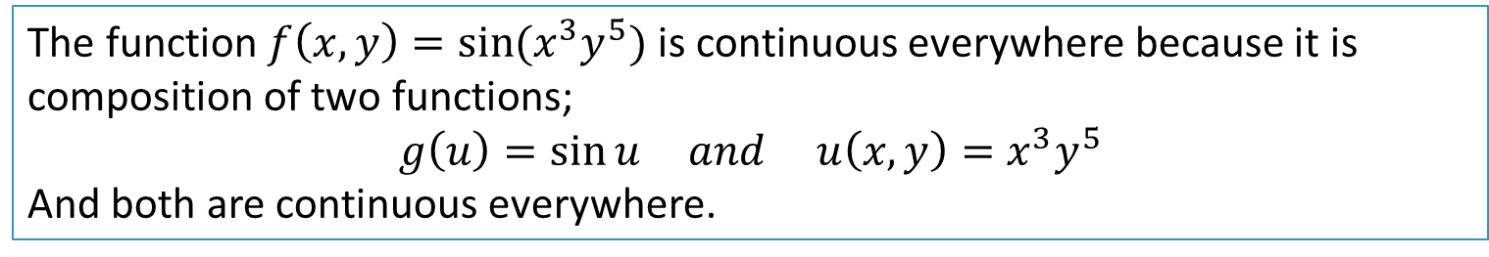
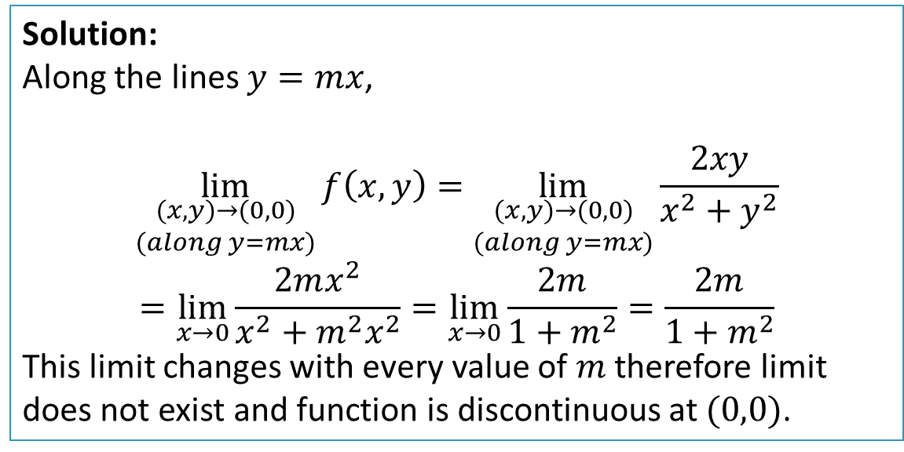
Example 3:
The function $f\left(x,y\right)=\sin{(x^{3}y^{5})}$ is continuous everywhere because it is composition of two functions;
$$g\left(u\right)=\sin{u} and u\left(x,y\right)=x^{3}y^{5}$$
And both are continuous everywhere.
Example 4:
Discuss continuity of the function
$$f\left(x,y\right)=\left\{\begin{aligned}\frac{2xy}{x^{2}+y^{2}} x≠0 \\ 0 x=0\end{aligned}\right.$$
at $(0,0)$.
Solution:
Along the lines $y=mx$,
$$\lim_{\begin{aligned}(x,y)→(0,0) \\ (along y=mx)\end{aligned}}{f\left(x,y\right)}=\lim_{\begin{aligned}(x,y)→(0,0) \\ (along y=mx)\end{aligned}}{\frac{2xy}{x^{2}+y^{2}}}$$
$$=\lim_{x→0}{\frac{2mx^{2}}{x^{2}+m^{2}x^{2}}}=\lim_{x→0}{\frac{2m}{1+m^{2}}}=\frac{2m}{1+m^{2}}$$
This limit changes with every value of $m$ therefore limit does not exist and function is discontinuous at $(0,0)$.

Slide 8
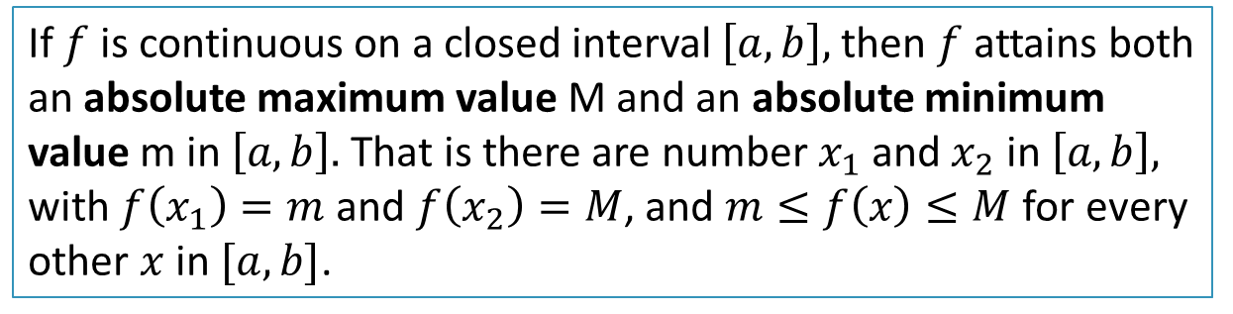
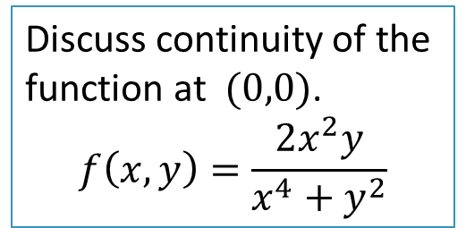
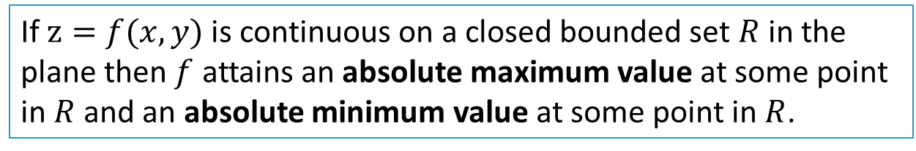
Practice Question:
Discuss continuity of the function at $(0,0)$.
$$f\left(x,y\right)=\frac{2x^{2}y}{x^{4}+y^{2}}$$
Suggested Exercise 14.2: you can skip questions related to three variables.
The Extreme Value Theorem for Absolute Extrema for Single Variable Functions
If $f$ is continuous on a closed interval $\left[a,b\right],$ then $f$ attains both an absolute maximum value M and an absolute minimum value m in $\left[a,b\right].$ That is there are number $x_{1}$ and $x_{2}$ in $\left[a,b\right],$ with $f\left(x_{1}\right)=m$ and $f\left(x_{2}\right)=M$, and $m≤f\left(x\right)≤M$ for every other $x$ in $[a,b]$.
Same is true for functions of several variables.
The Extreme Value Theorem for Absolute Extrema for Functions of two variables
If $z=f(x,y)$ is continuous on a closed bounded set $R$ in the plane then $f$ attains an absolute maximum value at some point in $R$ and an absolute minimum value at some point in $R$.

